Slide 1
Intensity Plot UX Analysis
July 25th 2019

Slide 2
Analysis of Improvements
Current | Proposed
Overview page is obviously not designed for 3rd Party consumers and is too verbose | Target 3rd Party consumers by making the overview/landing page simpler and more inviting
A lot of functionality is not needed | Reduce clutter and focus on the salient feature of easy grouping/visualization of microsatellites
Hard to discover how to get started | Feature “Get Started” button prominently
UI is unintuitive and too many clicks are needed to achieve a basic visualization | Make UI crisp and follow Web 2.0/3.0 UX best practices
Intensity plot scrolls off the page if there are too many rows | Keep a floating intensity plot on top of the rows so its always visible

Slide 3
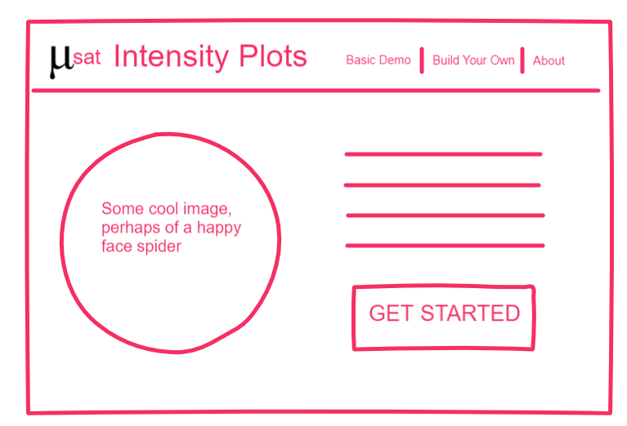
Proposed landing Page
A few lines to convey salient features
Slick animation or rich graphic to convey gist of site

Slide 4
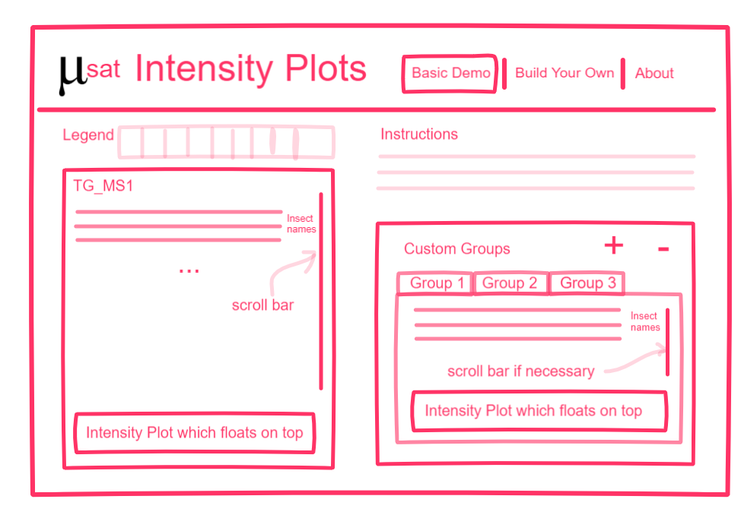
OLD Demo Page (TG_MS1)
Note: we got feedback that the Custom group should be allowed to be renamed and that tabs would not work so this mock-up was reworked
Hard-coded TG_MS1 on the left side, custom groups on right
Intensity Plot is floating on top of the individual samples
Notes:
Note: we got feedback that the Custom group should be allowed to be renamed and that tabs would not work so this mock-up was reworked. Please see the next slide for the rework

Slide 5
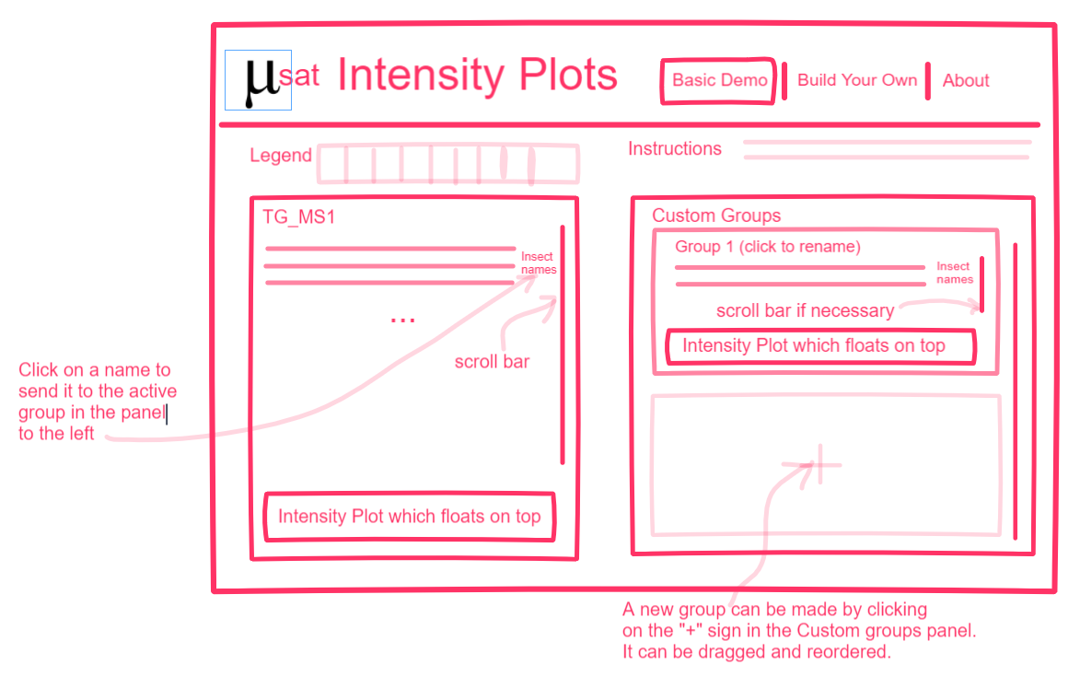
Demo Page (TG_MS1)
Hard-coded TG_MS1 on the left side, custom groups on right
Intensity Plot is floating on top of the individual samples

